Slide 1

Stage 6/ Bay 5 Hilarity Ensues (Eurotrash Edition) Course Designer: Eric Beerbaum
Hilarity Ensues (Eurotrash Edition) is a 16 round, 80 point Virginia Count medium course. There are 16 IPSC targets. The best one hit per target will score. The start signal is audible.
Handgun start position is both hands touching upper mark. Handgun is loaded and holstered. PCC starting position is PCC loaded, safety on, stock touching belt, muzzle touching lower mark.
On the audible start signal, engage all targets from within the shooting area. Everything behind the front fault line is the shooting area.

Slide 2
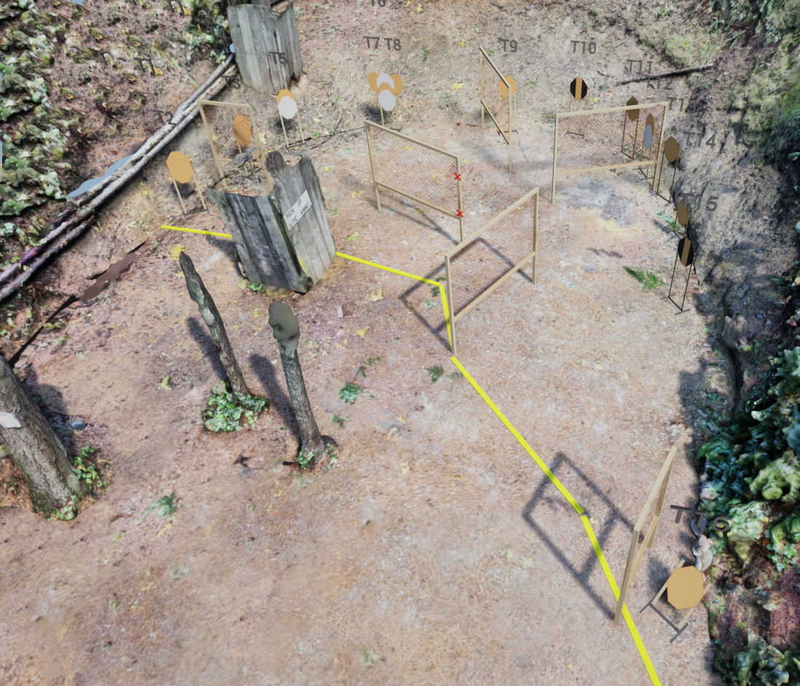
 | Stage 6/ Bay 5 Hilarity Ensues (Eurotrash Edition) Course Designer: Eric Beerbaum

